Slide 1

Lic. en Sistemas
Inglés Nivel 1

Slide 2

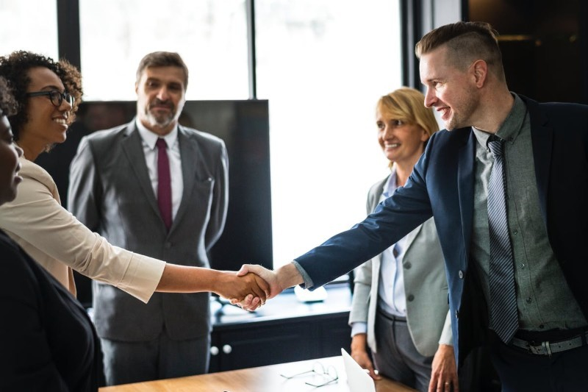
Unit 7
IT Support

Slide 3
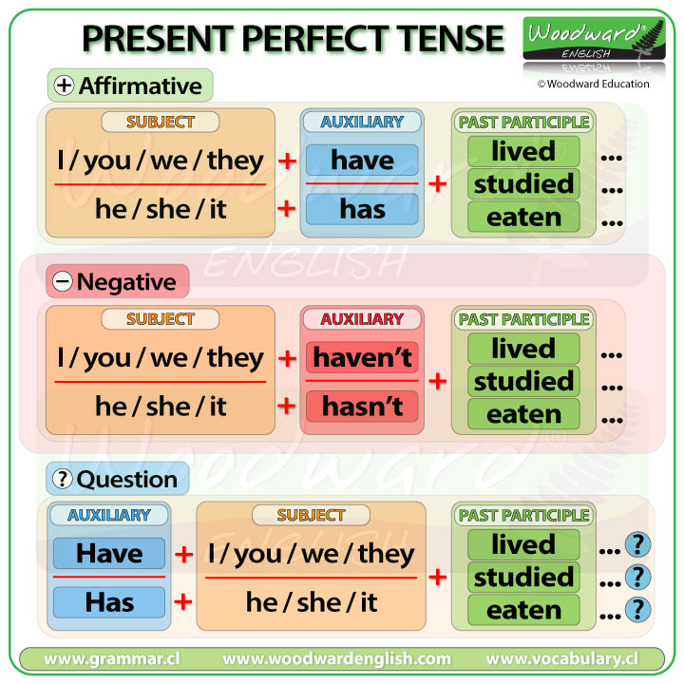

Slide 4


Slide 5
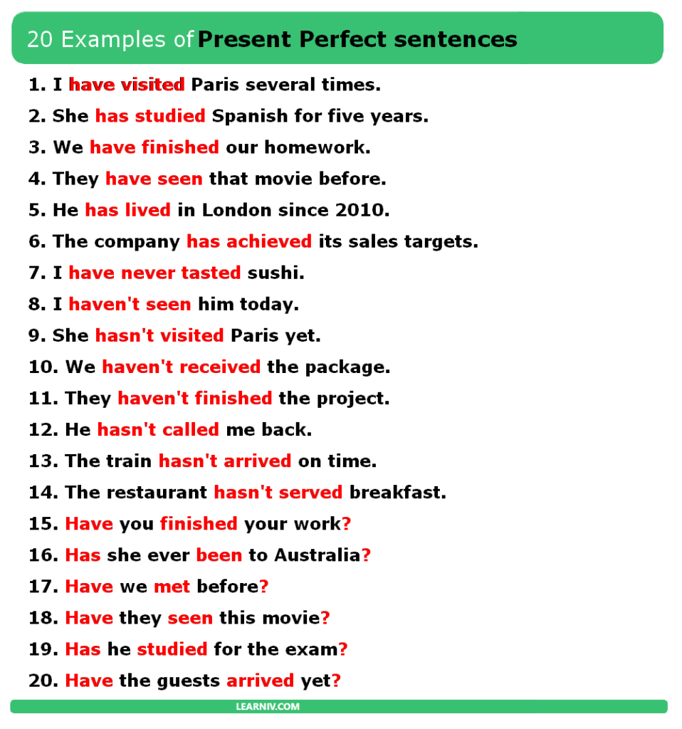

Slide 6
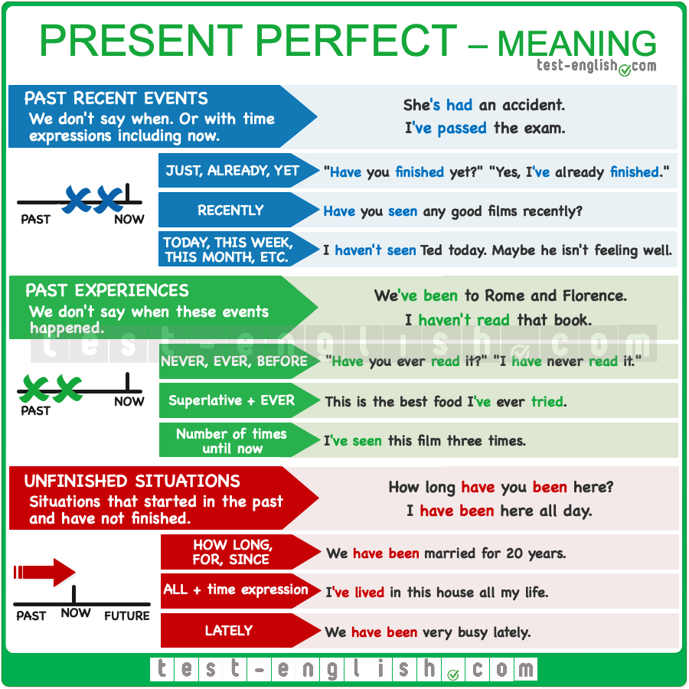

Slide 7
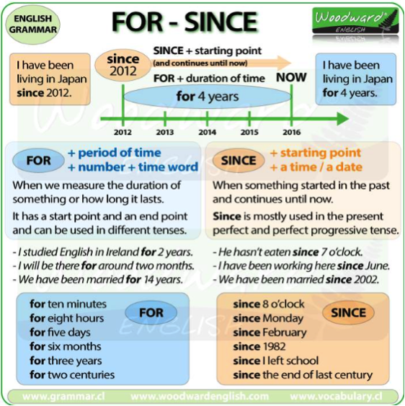

Slide 8
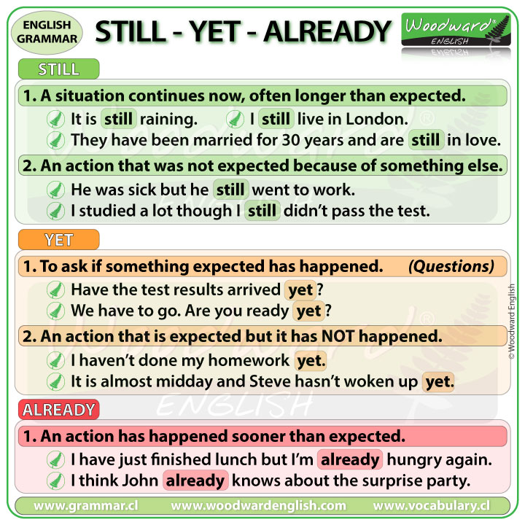

Slide 9
Fill in MUST or MUSTN'T
You ______ try some pasta. This cook makes great Italian food.
I ______ go to the rest room. I'll be back in a minute.
I really ______ go now. I have a friend waiting for me in the park.
I ______ forget to phone mum. It's her birthday.
You ______ really go and see the new Walt Disney film. It's great !
You ______ send any private emails from this server. The company doesn't allow it.
We ______ have run out of sugar. I remember to get some on my way back home.
You ______ smoke in this room. It's forbidden.
You ______ come and visit us when you're in New York. we'd love to have you.
John, you ______ feed the cat all day long. It's not healthy for her.
Children ______ leave their parents. Otherwise, they could get lost
I ______ forget to go to the bank later. I haven't got any money left

Slide 10
Complete the sentences using MUST or CAN’T .
You've been travelling the whole day . You _______ be tired.
The restaurant _______ be good. It's full of people.
The restaurant _______ be good. It's always empty.
Carol _______ get bored on the job. She does the same things every day.
You just had lunch. You be _______ very hungry.
They haven't lived here very long. They _______ know that many people.
The phone rang and I didn't hear it. I _______ have been asleep.
The house is near the motorway. It _______ be very noisy.
You are going on holiday next week. You _______ be looking forward to it.
It rained every day during their stay, so they _______ have had a nice holiday.
Congratulations on passing your exam. You _______ be very pleased.
You got here very quickly. You _______ have walked very fast.
Bill and Sue travel a lot, so they _______ be short of money.
I've lost one of my gloves. I _______ have dropped it somewhere.

